Slide 1
Lecture 2: Abstraction and Functions

Slide 2
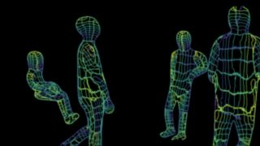
Computing In The News
Wi-Fi Routers Can Detect Human Locations, Poses Within a Room Tom's Hardware Mark Tyson January 18, 2023 Carnegie Mellon University scientists have been testing a system that uses Wi-Fi signals to detect the positions and poses of people in a room. The researchers positioned TP-Link Archer A7 AC1750 Wi-Fi routers at either end of the room, while algorithms generated wireframe models of people in the room by analyzing the signal interference the people caused. The researchers based the perception system on Wi-Fi signal channel-state-information, or the ratio between transmitted and received signal waves.
A computer vision-capable neural network architecture processes this data to execute dense pose estimation; the researchers deconstructed the human form into 24 segments to accelerate wireframe representation. They claim the wireframes' position and pose estimates are as good as those generated by certain "image-based approaches."

Slide 3
Announcements
Join the EECS 101 and DATA 001 Ed Discussions!
https://eecs.link/join-ed
https://eecs.link/data-ed
Hopefully not needed! Please, report any concerns about class / campus climate to the department. You are welcome here!
https://eecs.link/climate

Slide 4
Announcements – Waitlist and Exams
We are working to expand the course.
Usually 10-15% people get off the waitlist.
This year it keeps growing. ☹
Keep up with the class!
Section Signups Released Yesterday
Please sign up and attend a regular section
Megasection: Useful if you want a little less interactivity.
We will track attendance, but not for a grade!
Exams (reminder):
Midterm: Tue October 10
Final: Thu Dec 14

Slide 5
Links
Q&A Thread: https://go.c88c.org/qa2
Self-Check: https://go.c88c.org/2
Website Google Calendar: https://c88c.org/fa23/weekly-schedule.html

Slide 6
Abstraction

Slide 7

Abstraction
Detail removal
“The act of leaving out of consideration one or more properties of a complex object so as to attend to others.”
Generalization
“The process of formulating general concepts by abstracting common properties of instances”
Technical terms: Compression, Quantization, Clustering, Unsupervized Learning
Henri Matisse “Naked Blue IV”

Slide 8
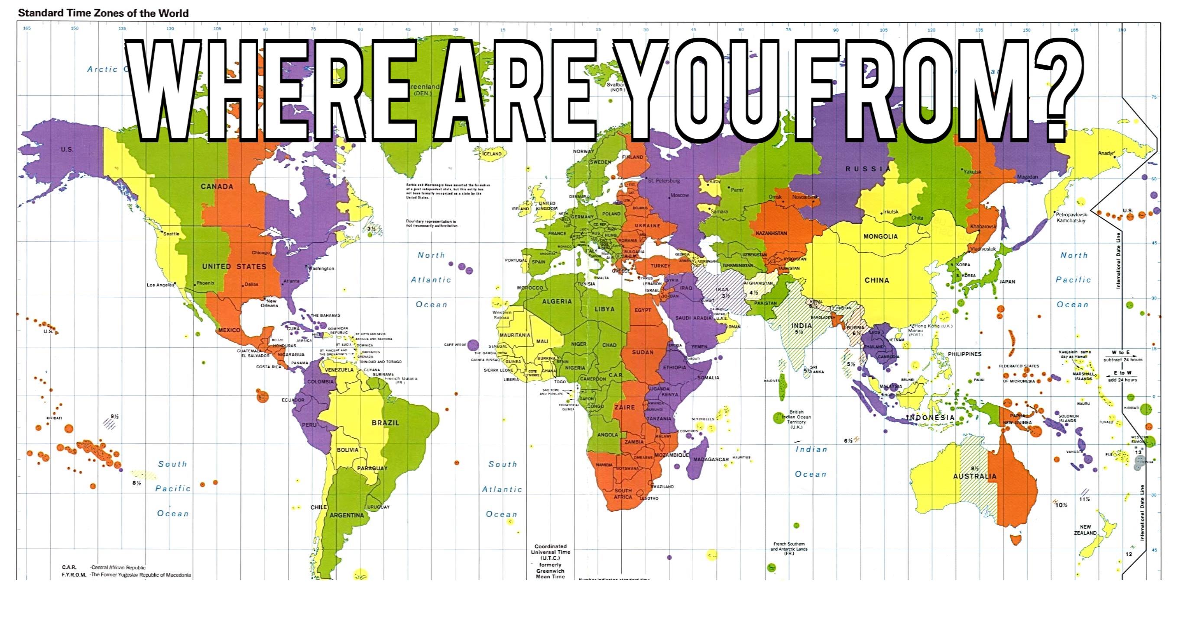
Experiment – Where are you from?

Slide 9

Where are you from?
Possible Answers:
Planet Earth
Europe
California
The Bay Area
San Mateo
1947 Center Street, Berkeley, CA
37.8693° N, 122.2696° W
All correct but different levels of abstraction!

Slide 10
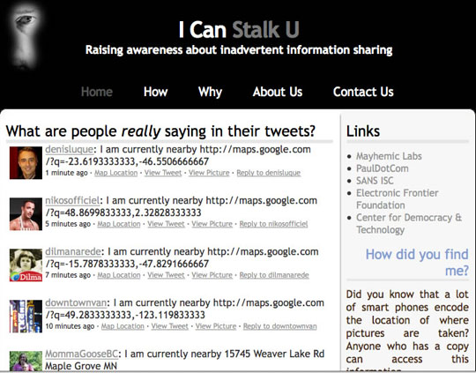
Abstraction gone wrong!

Slide 11
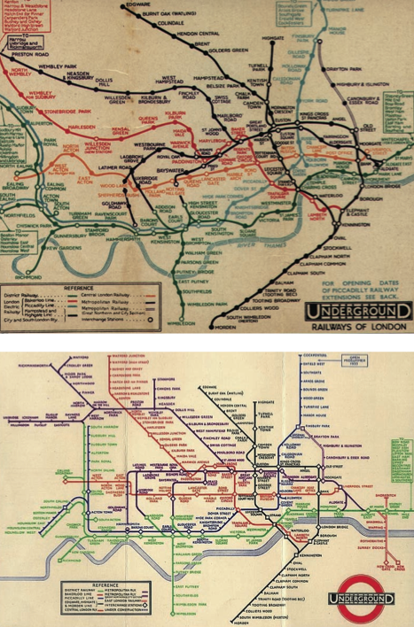
Detail Removal (in Data Science)
You’ll want to look at only the interesting data, leave out the details, zoom in/out…
Abstraction is the idea that you focus on the essence, the cleanest way to map the messy real world to one you can build
Experts are often brought in to know what to remove and what to keep!
The London Underground 1928 Map & the 1933 map by Harry Beck.

Slide 12
The Power of Abstraction, Everywhere!
Examples:
Math Functions (e.g., sin x)
Hiring contractors
Application Programming Interfaces (APIs)
Technology (e.g., cars)
Amazing things are built when these layer
And the abstraction layers are getting deeper by the day!
We only need to worry about the interface, or specification, or contract
NOT how (or by whom) it’s built
Above the abstraction line
Abstraction Barrier (Interface) (the interface, or specification, or contract)
Below the abstraction line
This is where / how / when / by whom it is actually built, which is done according to the interface, specification, or contract.

Slide 13
Abstraction: Pitfalls
Abstraction is not universal without loss of information (mathematically provable). This means, in the end, the complexity can only be “moved around”
Abstraction makes us forget how things actually work and can therefore hide bias. Example: AI and hiring decisions.
Abstractions can formalize a design or pattern. When something doesn't follow that pattern–perhaps a new use case emerges–it can be a burden to adapt.

Slide 14

Algorithm
An algorithm (pronounced AL-go-rith-um) is a procedure or formula to solve a problem.
An algorithm is a sequence of instructions to change the state of a system. For example: A computer’s memory, your brain (math), or the ingredients to prepare food (cooking recipe). Think Data 8: Change or retrieve the content of a table.

Slide 15
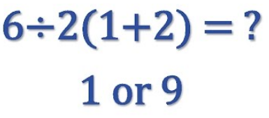
Algorithm: Properties
An algorithm is a description that can be expressed within a finite amount of space and time.
Executing the algorithm may take infinite space and/or time, e.g. ``calculate all prime numbers”.
In CS and math, we prefer to use well-defined formal languages for defining an algorithm.

Slide 16
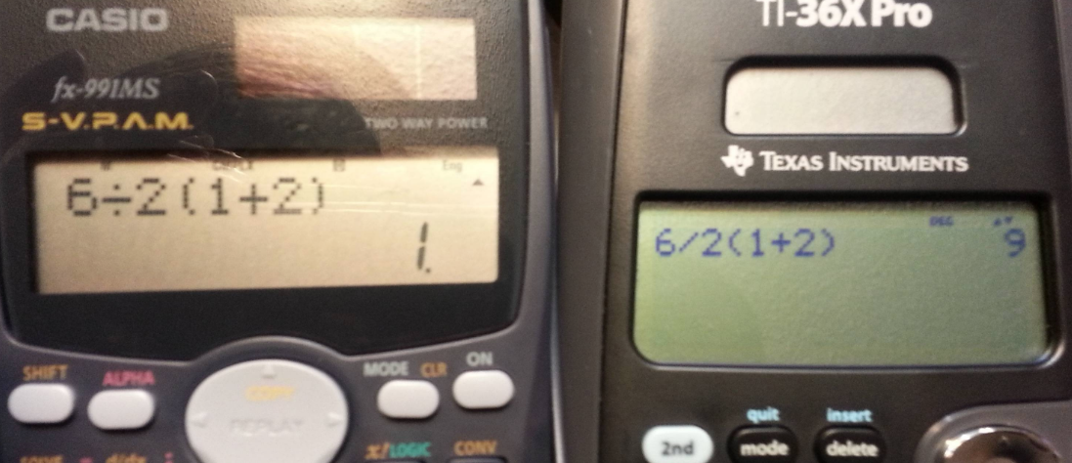
Algorithm: Well-Definition

Slide 17
Algorithms Early In Life (1st Grade)
1
carry (MSD)
7
operands
operator
+
8
5
least significant digit of result

Slide 18
Algorithms Early In Life (In Binary)
1
1
0
0
carry (MSD)
1
1
1
0
14
operands
1
1
0
0
+
12
operator
+
1
1
0
1
0
26
LSB result

Slide 19
More Terminology (Intuitive)
Code
A sequence of symbols used for communication between systems (brains, computers, brain-to-computer)
Data
Observations
Information
Reduction of uncertainty in a model (measured in bits)

Slide 20
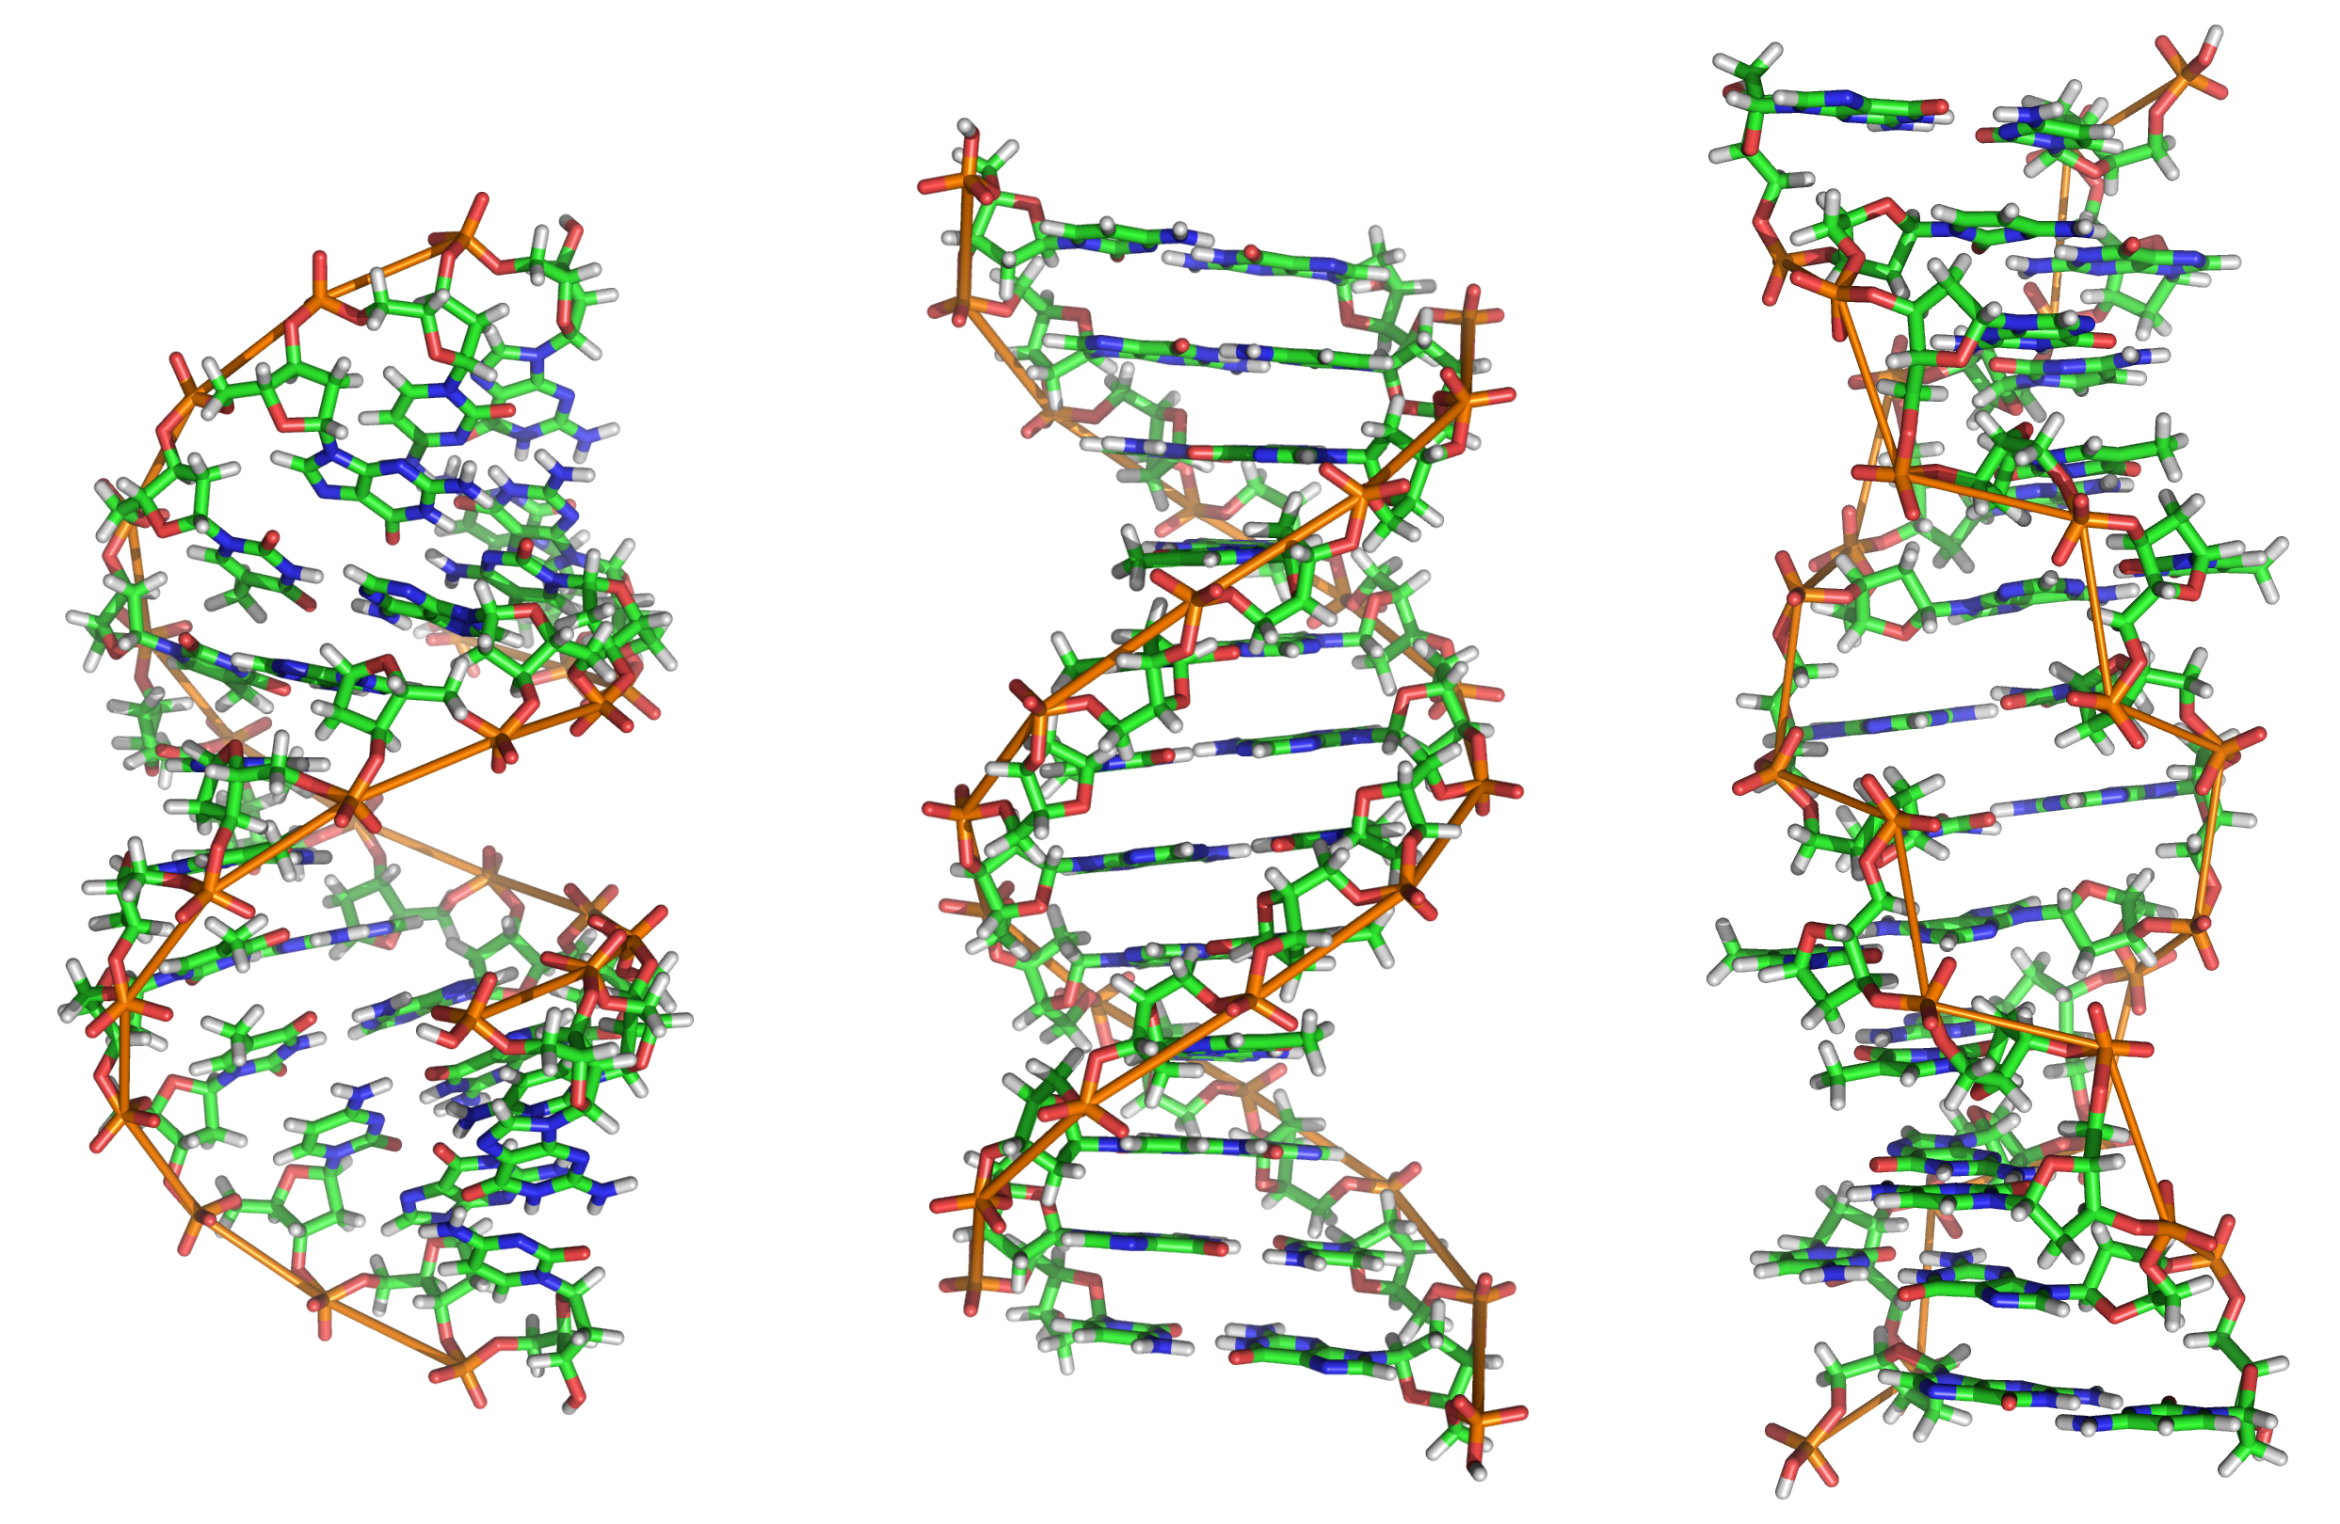
Data or Code?

Slide 21
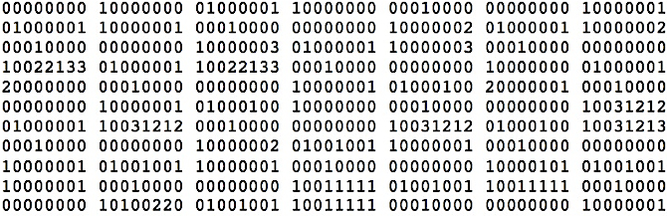
Data or Code?

Slide 22
Data or Code?
Here is some information!
Integer
Instruction
String

Slide 23
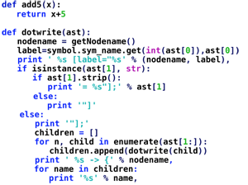
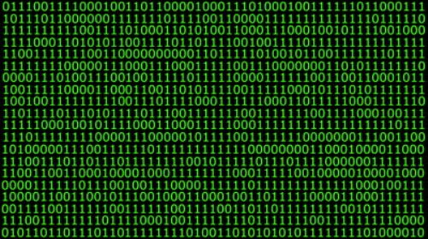
Data or Code? Abstraction→ Take CS61C
Human-readable code (programming language)
Machine-executable instructions (byte code)
Compiler or Interpreter
Here: Python

Slide 24
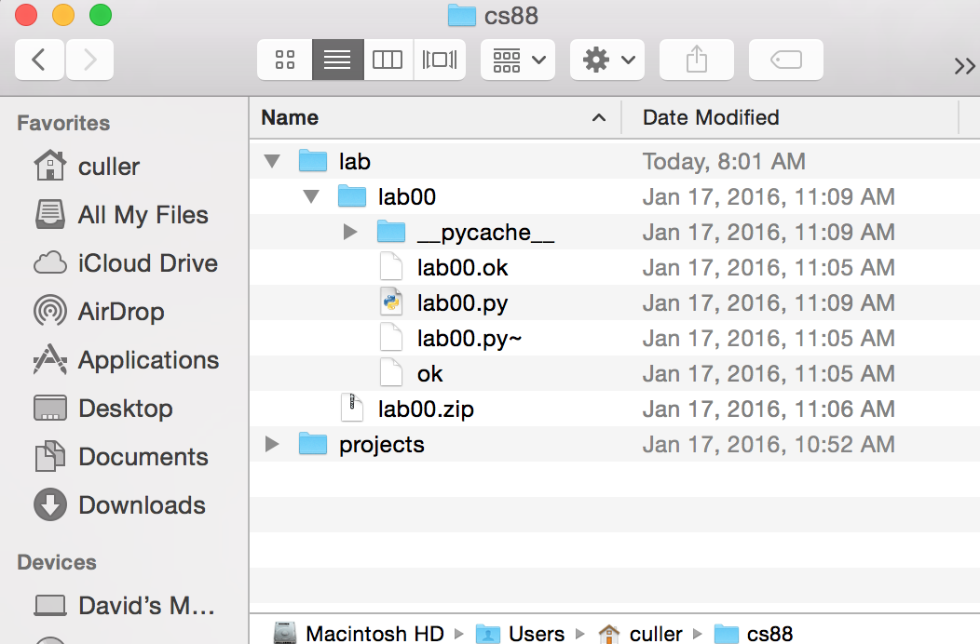
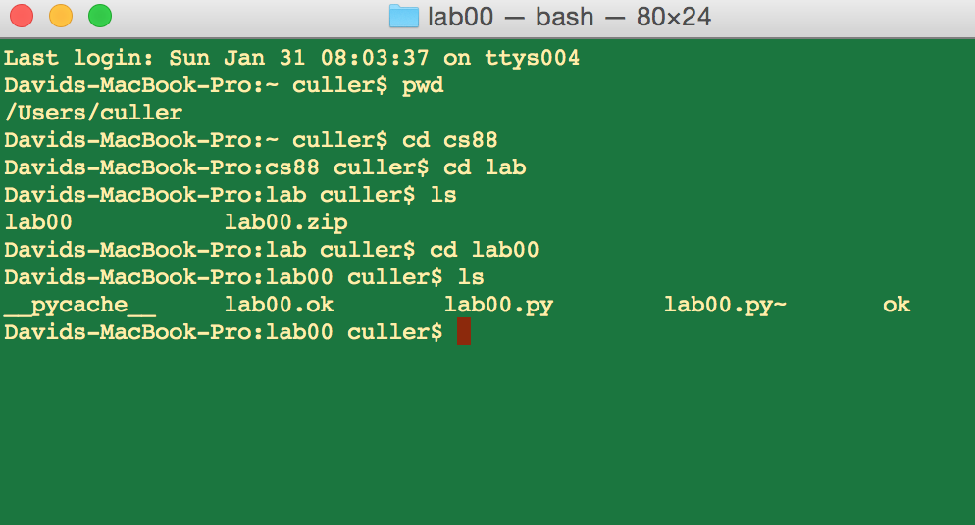
Computers Are Built On Abstractions
Big Idea: Layers of Abstraction
The GUI look and feel is built out of files, directories, system code, etc.

Slide 25
Review:
Abstraction:
Detail Removal or Generalizations
Code:
Is an abstraction!
Computer Science is the study (and building) of abstractions

Slide 26
Python: Simple Statements

Slide 27
Learning Objectives
Evaluate Python Expressions
Call Functions in Python
Assign data to Variables

Slide 28
Let’s talk Python
Expression 3.1 * 2.6
Call expression max(0, x)
Variables my_name
Assignment Statement my_name = <expression>
Define Statement: def function_name(<arguments>):
Control Statements: if … for …
while …
Comments # Text after the # is ignored.
Notes:
z = 1,2
x,y = 3,4
a,b = z

Slide 29
Boolean Expressions
Booleans are Yes/No values.
In Python: True and False
>, <, ==, !=, >=, <=, and, or
Note the the "double equals"
These expressions all return only True or False.
3 < 5 # returns True
You can write 3 < 5 == True – but this is redundant.
We'll keep practicing over time

Slide 30
Python Statements and Expressions
A statement is any particular piece of code
In an expression we care about the return value
print(‘Welcome to C88C!’)
course = ‘C88C’
print(‘Welcome to ‘ + course + ‘!’)
8 * 11
8 + 80
max(88, 61)
len('Berkeley')

Slide 31
Live Coding Demo
Open Terminal on the Mac
Type python3
We are now in the "interpreter" and can type code.
Python runs each line of code as we type it.
After each line, we see a result. This happens only in the interpreter.
It's a very useful calculator.
We can also run files!
python3 -i 02-Functions.py
-i : This means open the interpreter after running the file. It's optional
python3 ok …
This runs the file "ok" which is included with each lab / homework.

Slide 32
Python: Control Flow

Slide 33
Conditional Statement
Do some statements, conditional on a predicate expression
Example:
if <predicate>:
<true statements>
else:
<false statements>
if temperature > 98.6:
print(“fever!”)
else:
print(“no fever”)

Slide 34
Live Coding Demo
course = 'C88C'
time = '1:00'
if time == '1:00':
print("Go to " + course)
else:
print("Go to some other class")
Go to C88C

Slide 35
Live Coding Demo
>>> course = 'C88C'
>>> time = '1:00'
>>> if time == '1:00':
... print("Go to " + course)
... else:
... print("Go to some other class")
...
Go to C88C

Slide 36
Python: Function Definitions

Slide 37
Learning Objectives
Create your own functions.
Use if and else to control the flow of code.

Slide 38
Defining Functions
def <function name> (<argument list>) :
expression
return
Abstracts an expression or set of statements to apply to lots of instances of the problem
A function should do one thing well

Slide 39
Functions in Python
We "define" them with def
We typically name_them_using_underscores ("Snake case")
The first line ends in a :
The body is indented by 4 spaces
Arguments (parameters) create 'names' that exist only in our function
Most functions will return a value, but some do not.
def greet(name):
print("Hello, " + name)

Slide 40
Functions: Example
Let’s write a simple function which returns 8 more than the number.
We will call this function by writing add_8(80).
Inside, the name num will become the value 80.
def add_8(num):
”””add 8 to the input num
>>> add_8(80)
88
“””
return 8 + num

Slide 41
Functions: Example
>>> y = 5
>>> x = 3
>>> z = max(3, 5) * 10
>>> z
50
def max(x, y):
if x > y:
return x
else:
return y

Slide 42
How to Write a Good Function
Give a descriptive name
Function names should be lowercase. If necessary, separate words by underscores to improve readability. Names are extremely suggestive!
Chose meaningful parameter names
Again, names are extremely suggestive.
Write the docstring to explain what it does
What does the function return? What are corner cases for parameters?
Write doctest to show what it should do
Before you write the implementation.
Python Style Guide "PEP 8"

Slide 43
Live Coding Demo

Slide 44
Functions and Environments

Slide 45
Functions: Calling and Returning Results
Python Tutor
def max(x, y):
return x if x > y else y
x = 3
y = 4 + max(17, x + 6) * 0.1
z = x / y

Slide 46
Iteration With While Loops

Slide 47
Learning Objectives
Write functions that call functions
Learn How to use while loops.

Slide 48
while Statement – Iteration Control
Repeat a block of statements until a predicate expression is satisfied
<initialization statements>
while <predicate expression>:
<body statements>
<rest of the program>

Slide 49
Data-Driven Iteration
describe an expression to perform on each item in a sequence
let the data dictate the control
[ <expr with loop var> for <loop var> in <sequence expr > ]
def dividers(n):
"""Return list of whether numbers greater than 1 that divide n.
>>> dividers(6)
[True, True]
>>> dividers(9)
[False, True, False]
"""
return [divides(n,i) for i in range(2,(n//2)+1) ]

Slide 50
while Statement – Iteration Control
Repeat a block of statements until a predicate expression is satisfied
<initialization statements>
while <predicate expression>:
<body statements>
<rest of the program>
def first_primes(k):
""" Return the first k primes.
"""
primes = []
num = 2
while len(primes) < k :
if prime(num):
primes = primes + [num]
num = num + 1
return primes

Slide 51
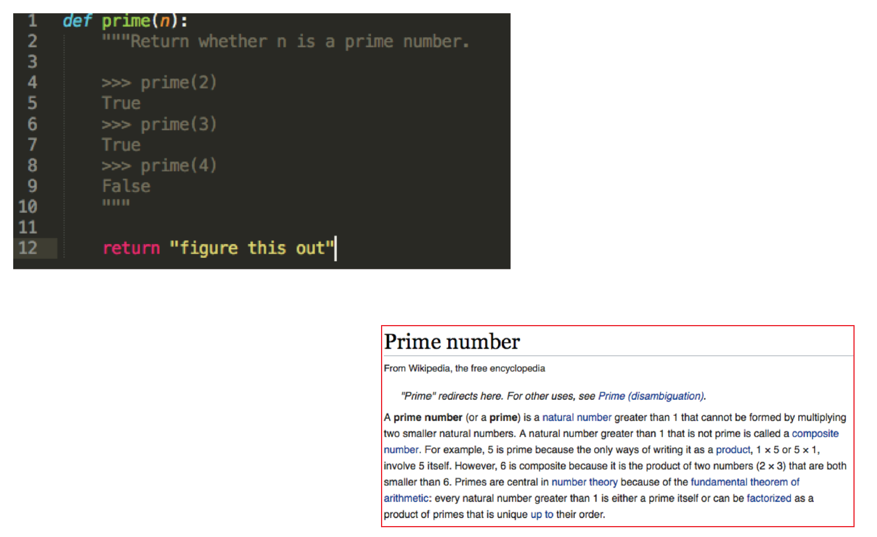
Example: Prime Numbers
Why do we have prime numbers?
https://www.youtube.com/watch?v=e4kevnq2vPI&t=72s&index=6&list=PL17CtGMLr0Xz3vNK31TG7mJIzmF78vsFO

Slide 52
for Statement – Iteration Control
Repeat a block of statements for a structured sequence of variable bindings
<initialization statements>
for <variables> in <sequence expression>:
<body statements>
<rest of the program>
def cum_OR(lst):
"""Return cumulative OR of entries in lst.
>>> cum_OR([True, False])
True
>>> cum_OR([False, False])
False
"""
co = False
for item in lst:
co = co or item
return co

